Slide 1
An Analysis of Epilepsy and Neurological Mortality
Irving A Gonzalez
Professor Peter J Wilcoxen
Advanced Policy Analysis – Spring 2022
May 4th, 2022

Slide 2
Background
Epilepsy is characterized as a pathologic and enduring tendency to have recurrent seizures
According to the CDC, the number of U.S. adults and children with epilepsy is increasing, with at least 3.4 million people living with the disorder
Policy reform within the US Department of Health and Human Services should occur to strategically finance projects geared towards disorders like epilepsy, as well as other neurological diseases

Slide 3
Data Source: CDC Wonder
Neurological Mortality
Epileptic Mortality
Grouped by:
ALL STATES
YEARS 1999 – 2020
ALL AGES
ALL GENDERS
ALL ORIGINS
ALL RACES
ICD-10 CODE: G00-G98 (Diseases of the nervous system)
Grouped by:
ALL STATES
YEARS 1999 – 2020
ALL AGES
ALL GENDERS
ALL ORIGINS
ALL RACES
ICD-10 CODE: G40 (Epilepsy)

Slide 4
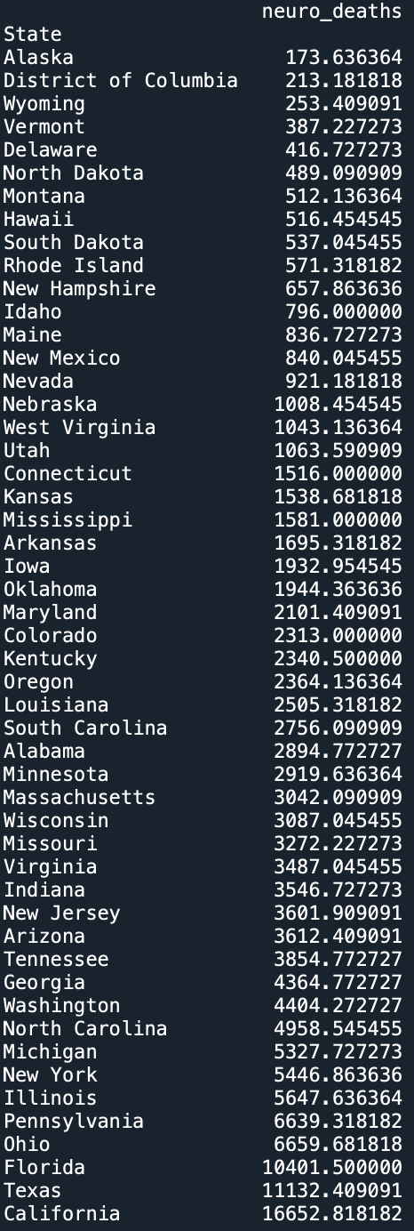
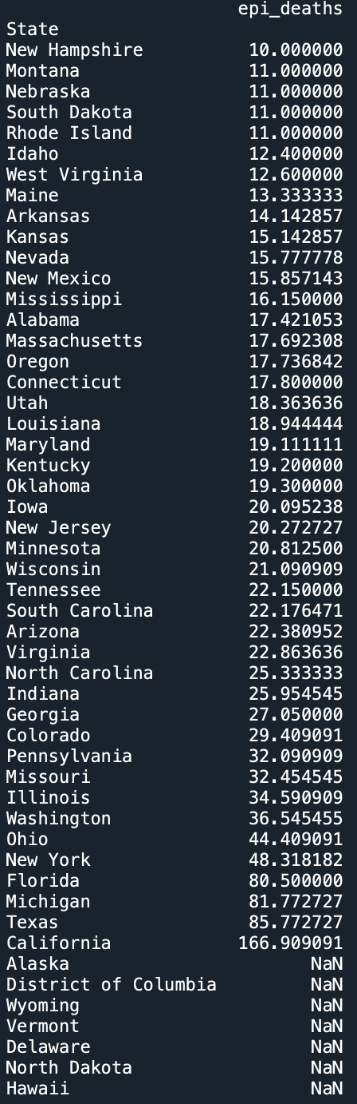
Ranking Death Counts
Neurological
Epilepsy
Top States:
CA
TX
FL
OH
PA
IL
NY
MI
NC
WA
Top States:
CA
TX
MI
FL
NY
OH
WA
IL
MO
PA

Slide 5
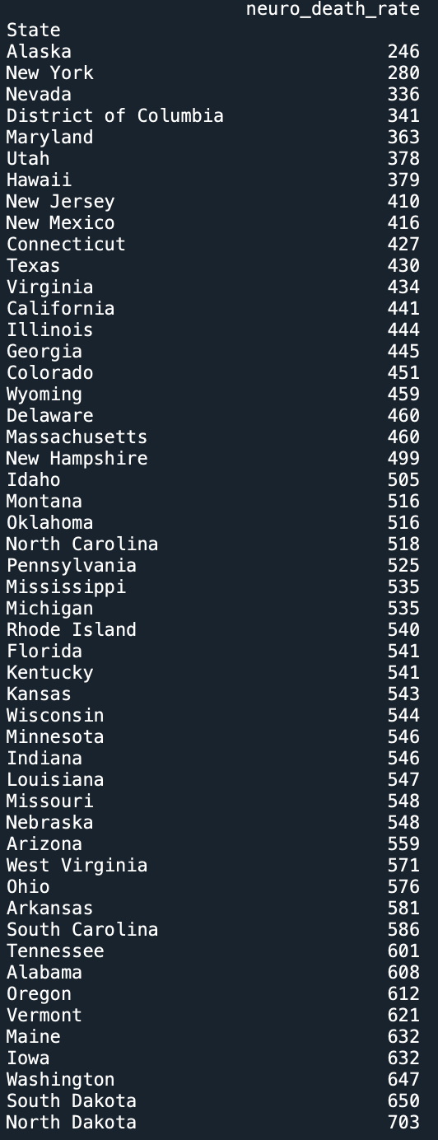
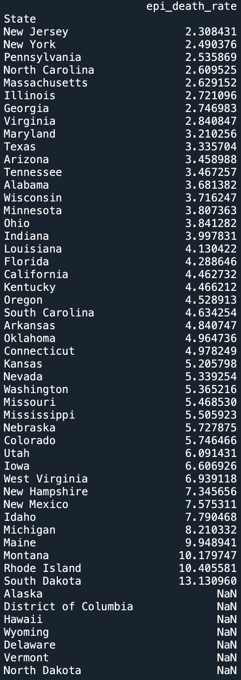
Ranking Death Rates
Neurological
Epilepsy
Top States:
ND
SD
WA
IA
ME
VT
OR
AL
TN
SC
Top States:
SD
RI
MT
ME
MI
ID
NM
NH
WV
IA

Slide 6
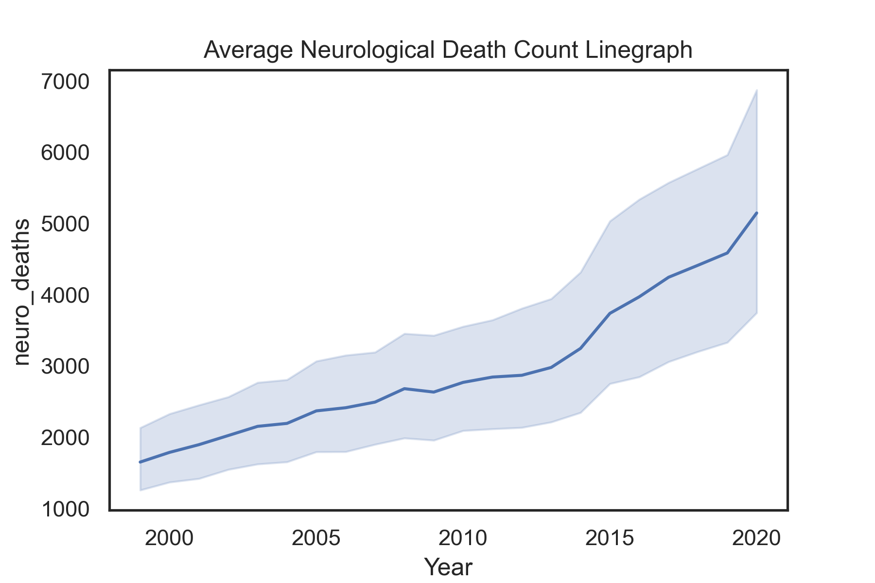
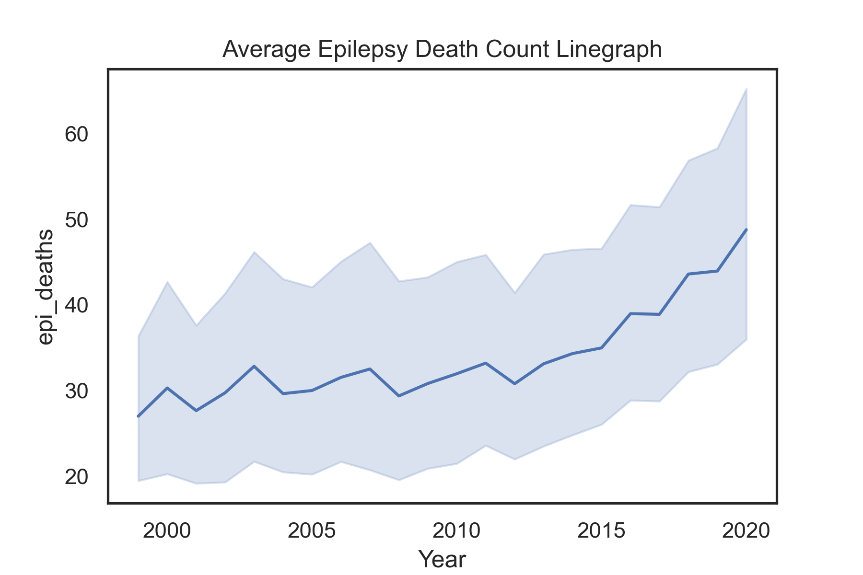
Average Death Count Evolution
Neurological
Epilepsy

Slide 7
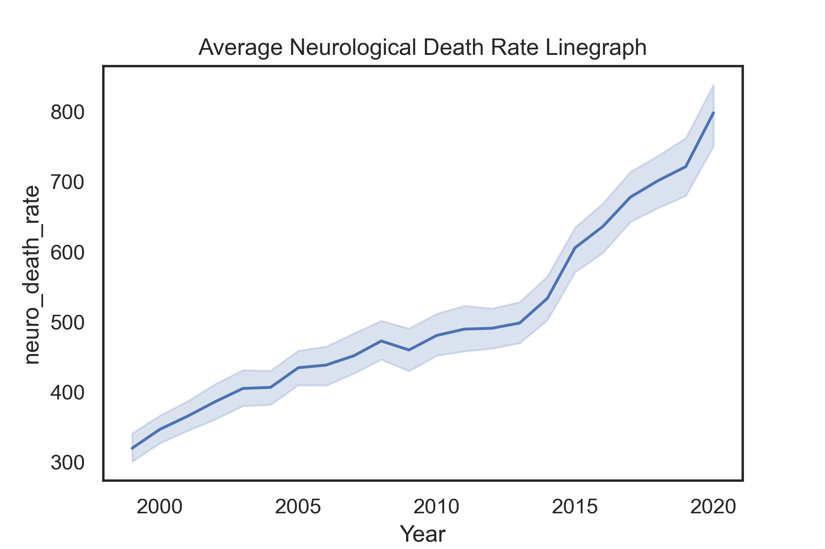
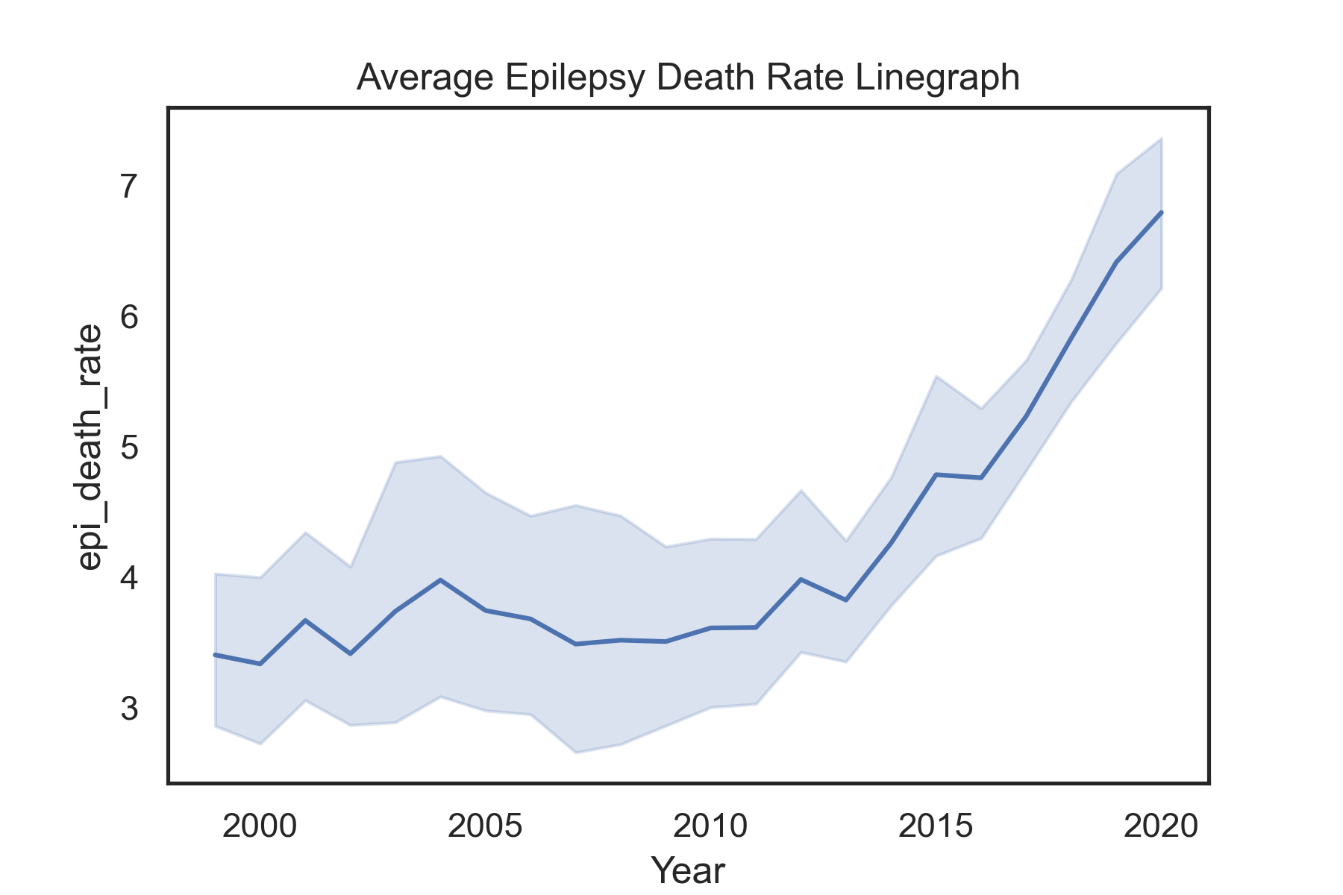
Average Death Rate Evolution
Neurological
Epilepsy

Slide 8
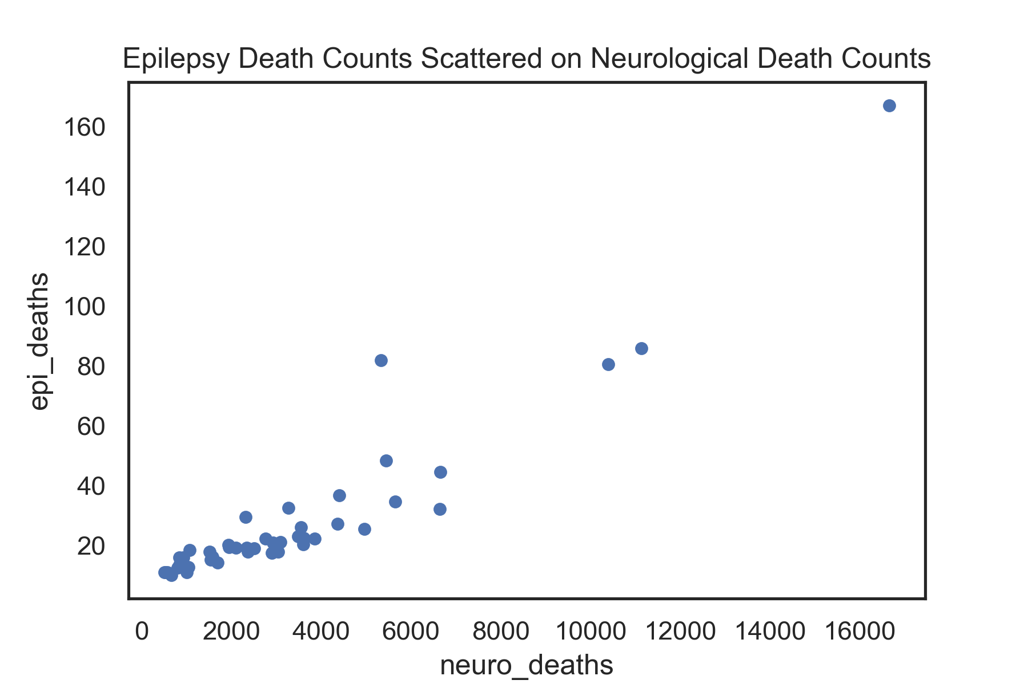
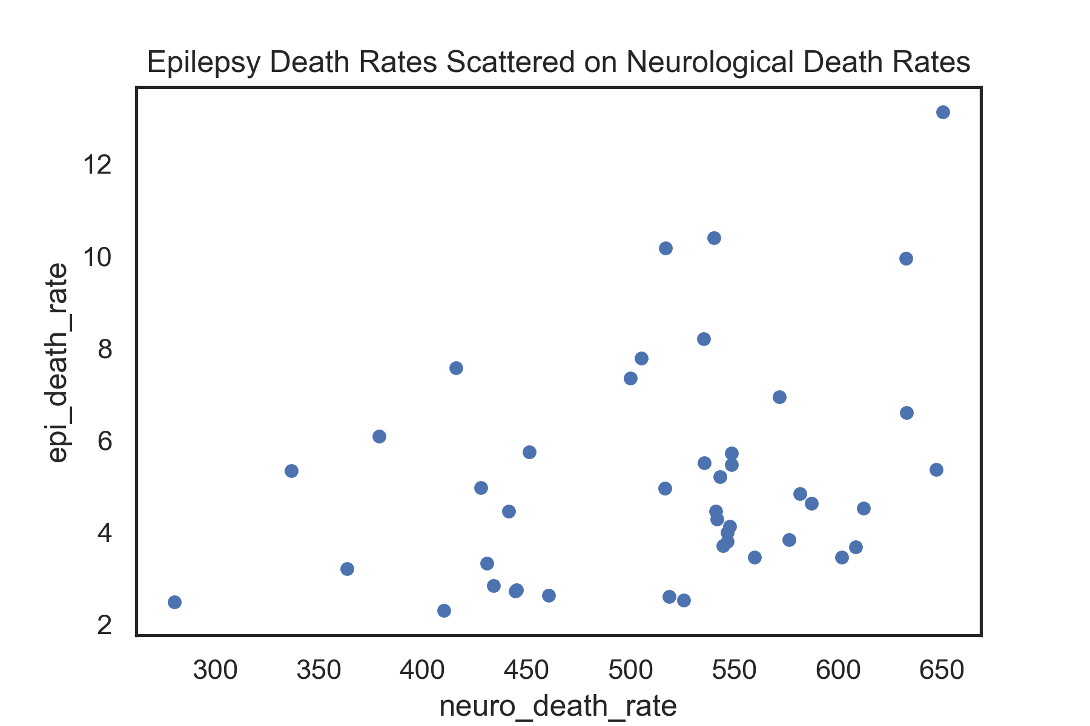
Is there a correlation between epileptic and neurological mortality?
Average Death Counts
Average Death Rates

Slide 9

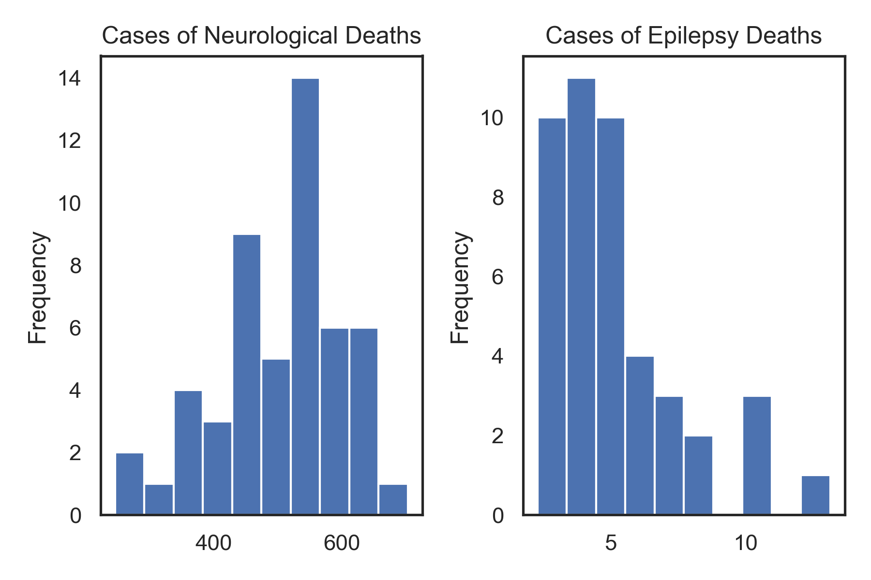
Average frequency of mortality cases

Slide 10
Future analysis
 | Merge mortality data onto geographic data
 | Project and visualize data using geopandas to create a map

Slide 11

Thanks!
Do you have any questions?
Please visit my repository to further explore this analysis at https://github.com/iagonzal/An-Analysis-of-Epilepsy-and-Neurological-Mortality

